Slide 1
Generating Supplementary Travel Guides from Social Media
Liu Yang, Jing Jiang*, Lifu Huang, Minghui Qiu, Lizi Liao
Peking University
Singapore Management University
Beijing Institute of Technology

Slide 2

Roadmap
Motivation
Our Method
Method Overview
Joint City Section Model
Section Specific Summarization
Experiments
Related Work
Summary
COLING 2014

Slide 3


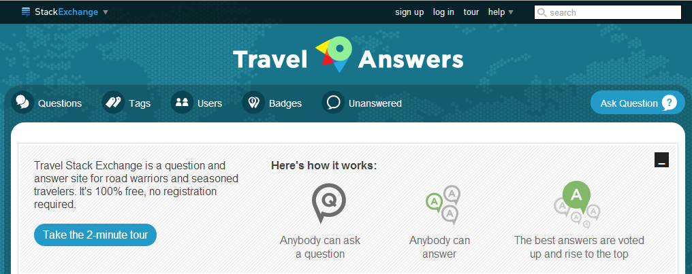



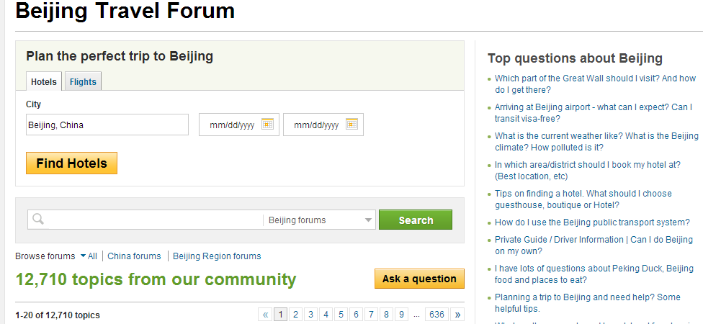
Online Forums and CQA Sites
Personal experience, opinions, suggestions and recommendations
Summarize question answering content from social media
COLING 2014

Slide 4
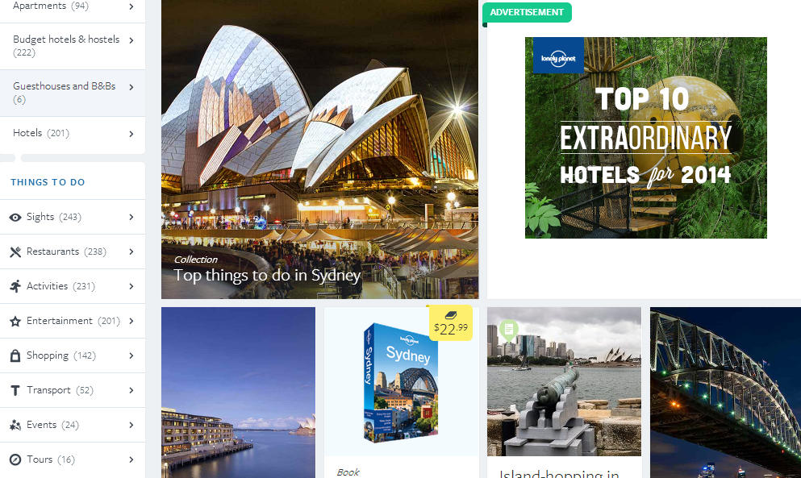
Social Media Content is Diverse and Noisy
Problems of directly applying existing multi-document summarization methods
Summaries without template structures
Miss coverage of point of interests
COLING 2014

Slide 5
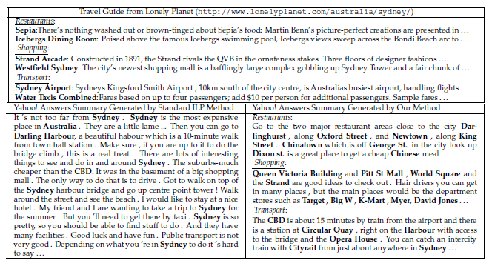
Motivation
Comparison of different travel guides about Sydney
COLING 2014

Slide 6
Motivation
Leverage the section structure of well-written travel guides and use a latent variable model to align forum threads
Integer Linear Programming (ILP)-based extractive summarization framework
Select sentences from forum threads to generate section-specific summaries
Emphasize the inclusion of potential points of interest for each section
Evaluate our method using real forum threads from Yahoo! Answers and human generated model summaries
COLING 2014

Slide 7
Motivation
Contributions
Study a new problem of summarizing multiple forum threads to generate city travel guides based on known template structure from well-written travel guides
Propose a principled approach based on latent variable models and Integer Linear Programming
Evaluate our method using real forum threads and human generated model summaries
COLING 2014

Slide 8
Roadmap
Motivation
Our Method
Method Overview
Joint City Section Model
Section Specific Summarization
Experiments
Related Work
Summary
COLING 2014

Slide 9
Method Overview
Thread selection
Use a latent variable model that jointly models official travel guides and forum threads
Allow the latent factors to adapt to the lexical variations in user-generated content
Align forum threads with the sections
Select the most relevant ones for each section
Section-specific summarization
ILP-based extractive summarization framework
Give preference to those more relevant sentences
Maximize the coverage of section-specific location entities
COLING 2014

Slide 10









Joint City Section Model
Section word distribution
City word distribution
Thread section distribution
c
$$θ_{j}$$
$$ψ_{s}$$
d
$$φ_{i}$$
L
$$x$$
w
z
$$y$$
$$M$$
N
K
$$J$$
I
I
$$S$$
$$π$$
Switch distribution
COLING 2014

Slide 11
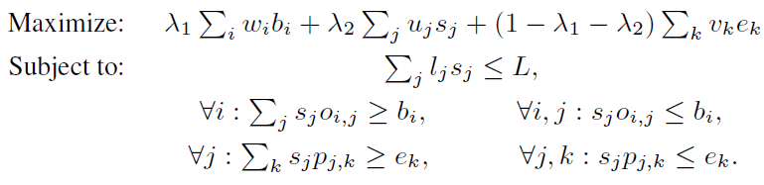
Section Specific Summarization
Build our solution on top of an ILP-based framework
Favoring relevant sentences
Measure relevance with respect to both the city and the section
Covering section-specific points of interest
COLING 2014

Slide 12
Roadmap
Motivation
Our Method
Method Overview
Joint City Section Model
Section Specific Summarization
Experiments
Related Work
Summary
COLING 2014

Slide 13
Experiments
Data and Experimental Setup
Use real data from Yahoo! Answers and Lonely Planet
Yahoo! Answers: top 60000 Q&A threads ranked by number of posts related to these 10 cities
Lonely Planet: 10 cities * 8 sections
Use Stanford NER tool to recognize named entities in threads(LOC, ORG and PER)
Pick the top 600 threads that have the most overlapping points of interest with the Lonely Planet travel guides for the training of JCSM
On average each thread contains 5.0 posts and 618.1 words.
COLING 2014

Slide 14
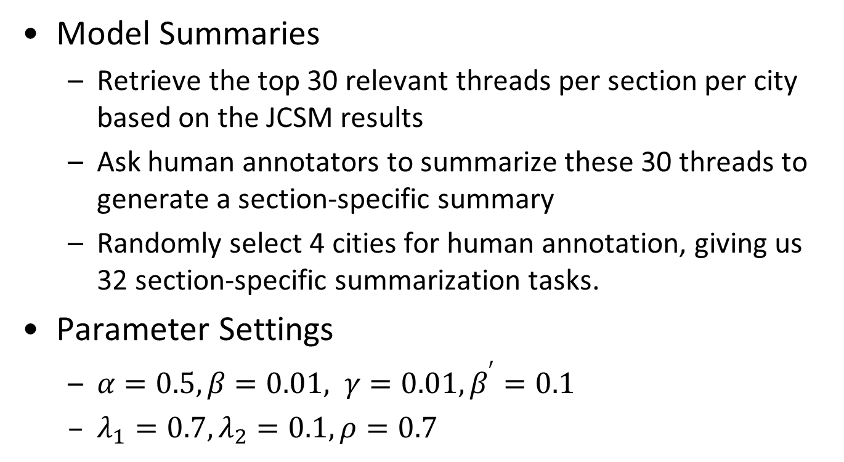
Experiments
Model Summaries
Retrieve the top 30 relevant threads per section per city based on the JCSM results
Ask human annotators to summarize these 30 threads to generate a section-specific summary
Randomly select 4 cities for human annotation, giving us 32 section-specific summarization tasks.
Parameter Settings
$α=0.5, β=0.01, γ=0.01, β^{′}=0.1$
$λ_{1}=0.7, λ_{2}=0.1, ρ=0.7$
COLING 2014

Slide 15
Experiments
Baselines
Random
Centroid (Radev et al., 2004)
LexRank (Erkan and Radev, 2004)
DivRank (Mei et al., 2010)
GMDS (Wan, 2008)
ILP-BL (Gillick and Favre, 2009)
Evaluation Metrics
ROUGE-1, ROUGE-2 and ROUGE-SU4
COLING 2014

Slide 16
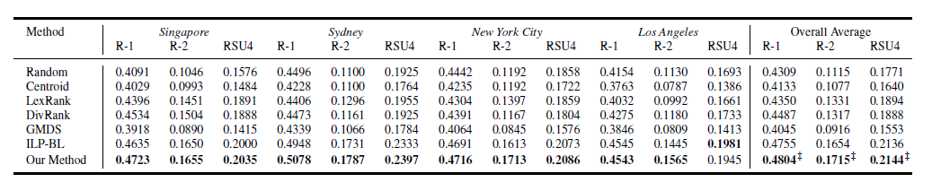
Experiments
Summarization Results
The ILP-based baseline clearly shows its advantage
Our method performs slightly better than ILP-BL based on the overall scores
COLING 2014

Slide 17
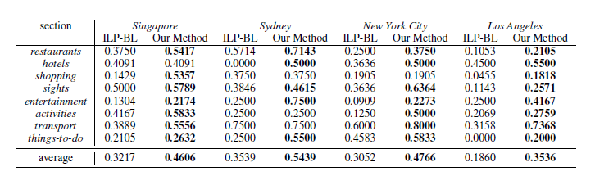
Experiments
Comparison of the recall of named entities of ILP-BL and our method
Our method clearly has a higher recall score than ILP-BL
Our method generates summaries with more potential points of interest
COLING 2014

Slide 18
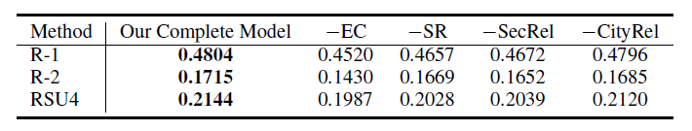
Experiments
Comparison a few degenerate versions of our method
Each degenerate version of our method performs worse than the complete method
Entity coverage and section-specific relevance seem to be the more important components
COLING 2014

Slide 19
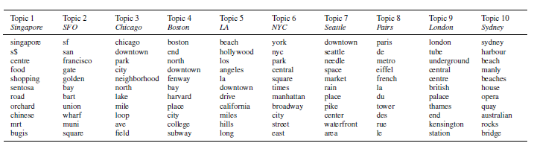
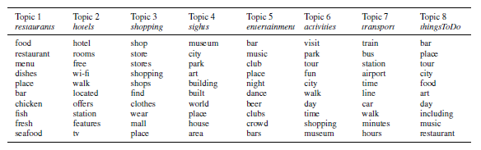
Experiments
Analysis of Topic Words
Top city specific words
Top section specific words
COLING 2014

Slide 20
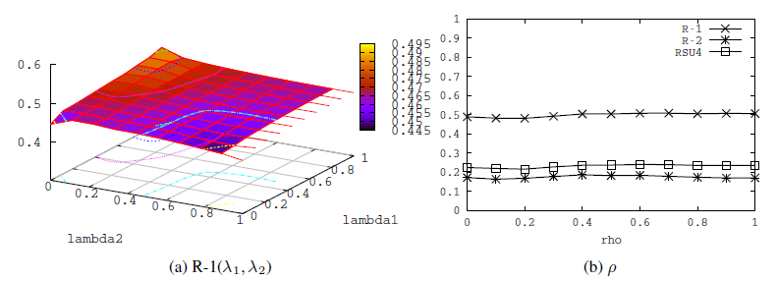
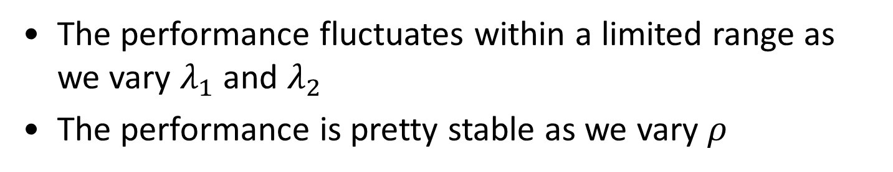
Experiments
Parameter Sensitivity Analysis
The performance fluctuates within a limited range as we vary $λ_{1}$ and $λ_{2}$
The performance is pretty stable as we vary $ρ$
COLING 2014

Slide 21
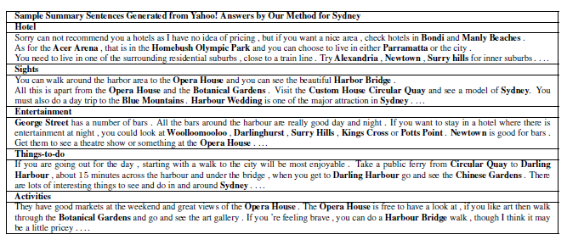
Experiments
Sample Output and Case Study
High relevance to the corresponding sections
Contain many points of interest as highlighted
COLING 2014

Slide 22
Roadmap
Motivation
Our Method
Method Overview
Joint City Section Model
Section Specific Summarization
Experiments
Related Work
Summary
COLING 2014

Slide 23
Related Work
Extractive summarization
Radev et al. (2004) proposed a centroid-based summarizer
Graph based ranking algorithms
LexPageRank (Erkan and Radev, 2004)
GMDS(Wan et al., 2007)
DivRank (Mei et al., 2010)
Integer Linear Programming
McDonald (2007) , Gillick and Favre (2009)
Differences of our work
Design a latent variable model to separate the threads to be summarized into sections
Emphasize the inclusion of potential points of interest in formulating the ILP optimization problem
COLING 2014

Slide 24
Related Work
Answer summarization in community-based QA sites
Liu et al. (2008) , Tomasoni and Huang (2010), Chan et al. (2012)
We study a new problem of summarizing multiple threads to automatically generate city travel guides based on known template structure from well-written travel guides
Different from the setting of single Q&A thread summarization in the previous related studies.
COLING 2014

Slide 25
Roadmap
Motivation
Our Method
Method Overview
Joint City Section Model
Section Specific Summarization
Experiments
Related Work
Summary
COLING 2014

Slide 26
Summary
Conclusion
Proposed a summarization framework to generate well structured supplementary travel guides from social media
Latent variable model and Integer Linear Programming
Additionally tries to cover more named entities as points of interest
Maximizes sentence relevance scores measured by the latent variable model
Extensive experiments with real data from Yahoo! Answers
Future Work
Emphasize the selection of additional information
Summarization without template structure
COLING 2014

Slide 27
Thank you
Q&A
The summary dataset used in this work can be found at https://sites.google.com/site/liuyang198908/code-data

